Slide 1
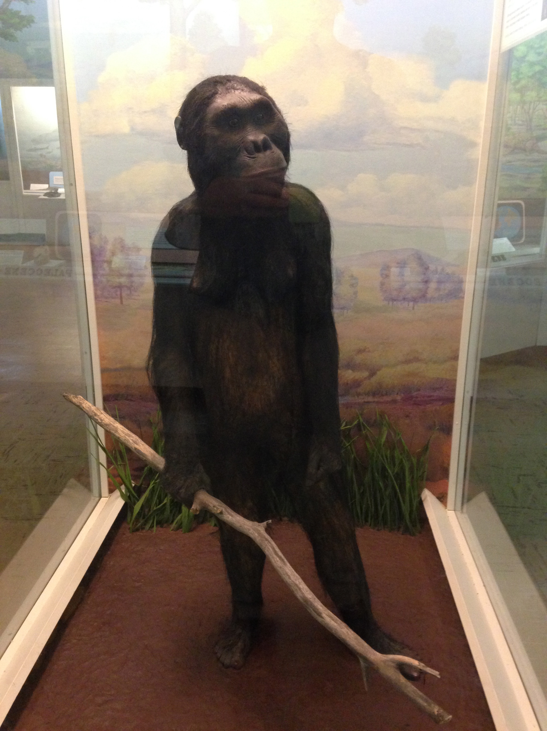
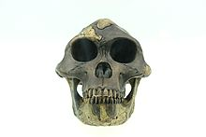
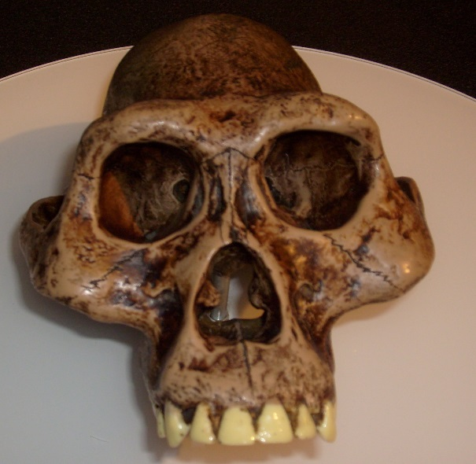
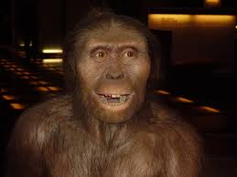
Australopithecus afarensis (Lucy)
3.8-2.9 mya
7
Notes:
Moving Left to Right:
1. J.Fick, MSU Museum
2. == Sumari == Reproducció d'una Australopithecus afarensis a Cosmocaixa, Barcelona, Catalunya. == Licensing == {{self2|GFDL|cc-by-sa-2.5,2.0,1.0}} Category:CosmoCaixa Category:Australopithecus ; http://en.wikipedia.org/wiki/File:Australopithecus_afarensis.JPG; user to credit listed as “1997”
3. Credit: Patrick Bürgler. 2010. {{Information |Description={{en|1=Reconstruction of the skull of an Australopithecus afarensis (aka Lucy). Photo taken: Museum of natural history, Basel (Switzerland).}}
4. {{Information |Description=Australopithecus afarensis reconstruction. Displayed at Museum of Man, San Diego, California. |Source=self-made |Date=4 December 2007 |Author= Durova |Permission=yes |other_versions=no }}

Slide 2
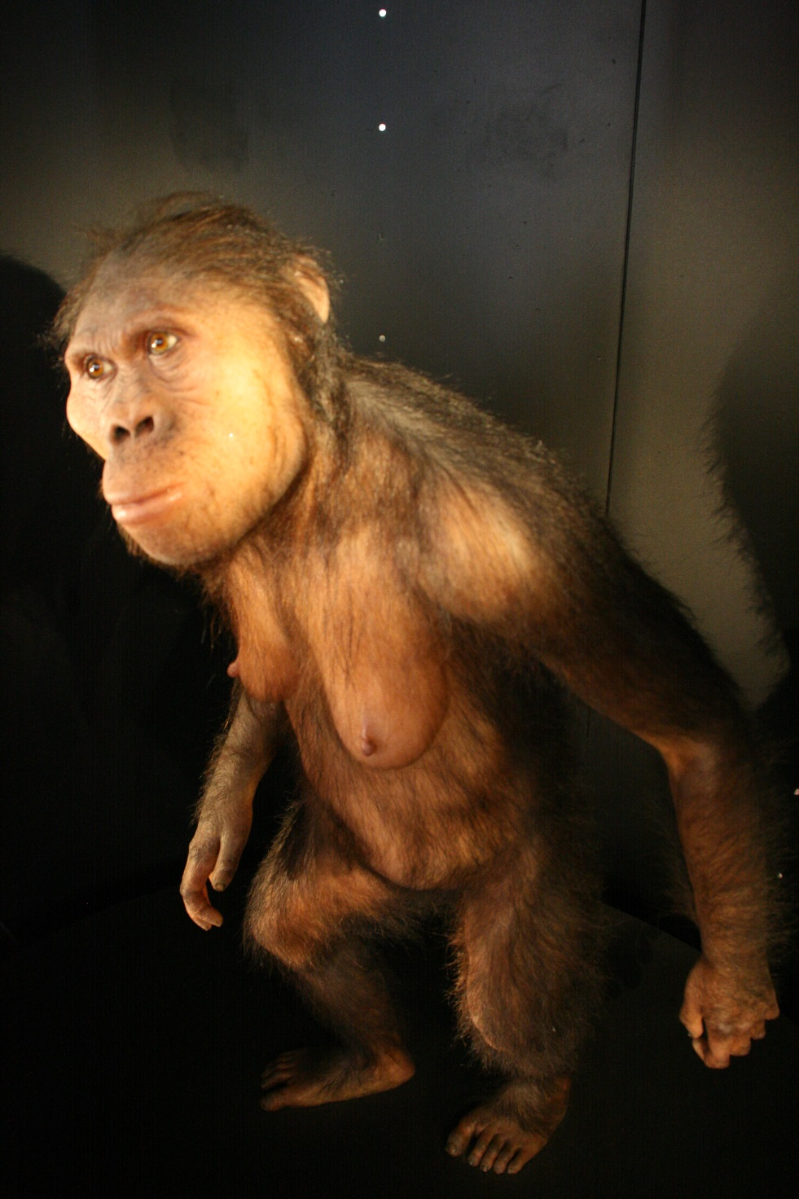
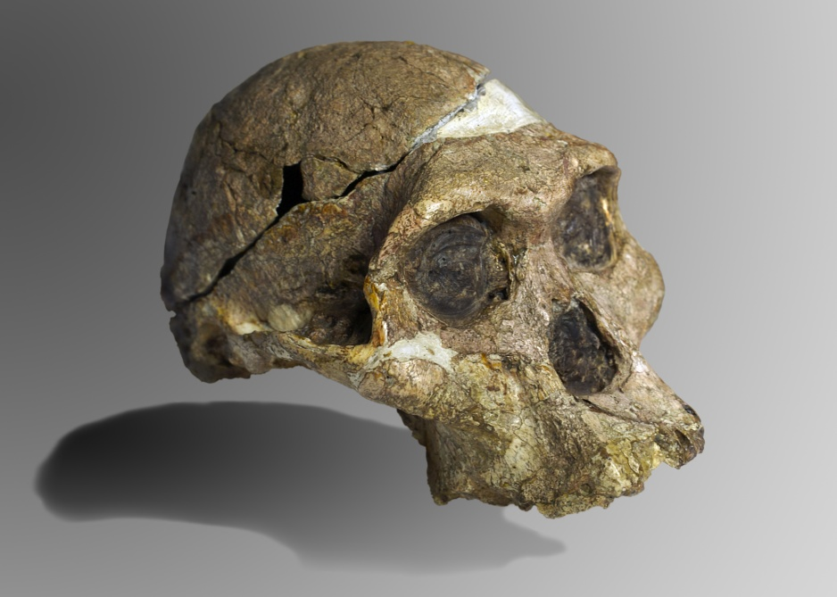
Australopithecus africanus
3.3-2.1 mya
6
Notes:
http://it.wikipedia.org/wiki/File:MEH_Australopithecus_africanus_29-04-2012_11-32-46_2592x3888.JPG
Credit: Nachosan
http://it.wikipedia.org/wiki/File:Mrs_Ples.jpg
The original complete skull (without upper teeth and mandible) of a 2.1 million year old Australopithecus africanus specimen so-called Mrs. Ples, discovered in South Africa. Collection of the Transvaal Museum, Northern Flagship Institute, Pretoria, South Africa. (catalogue number STS 5, Sterkfontein cave, hominid fossil number 5)
Credit: José Braga; Didier Descouens

Slide 3
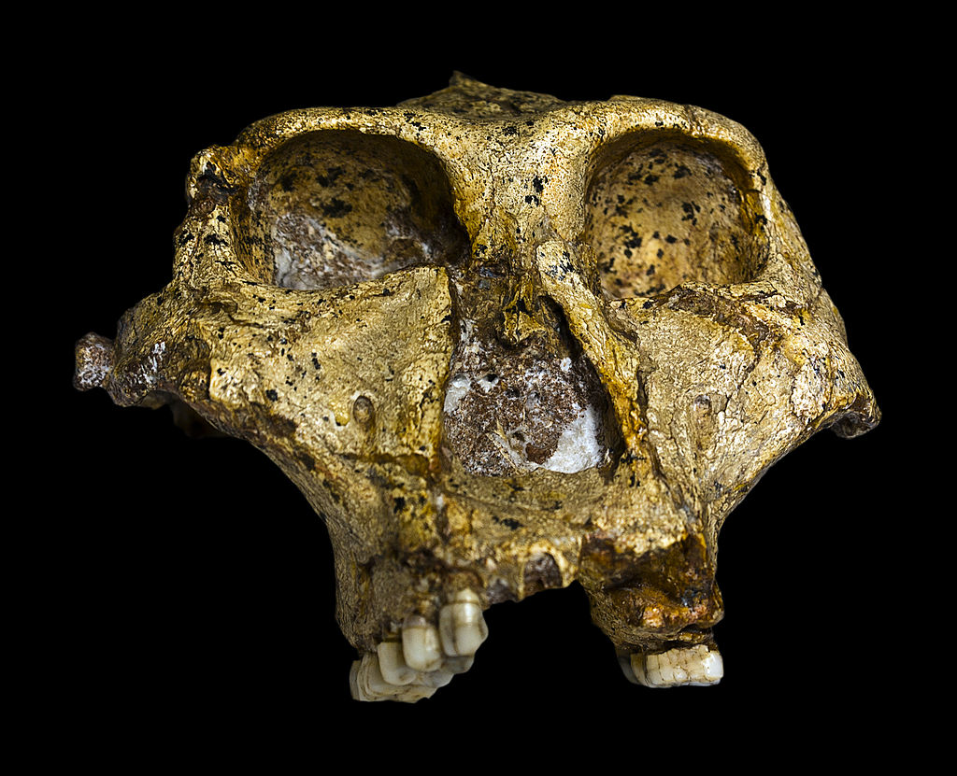
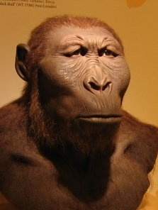
Paranthropus robustus
1.8-1.2 mya
5
CREATIVE COMMONS
Notes:
Moving left to right:
http://www.mclibre.org/otros/daniel_tomas/4eso/evolucion-humana/Paranthropus_robustus.htm
http://upload.wikimedia.org/wikipedia/commons/a/a1/Original_of_Paranthropus_robustus_Face.jpg

Slide 4
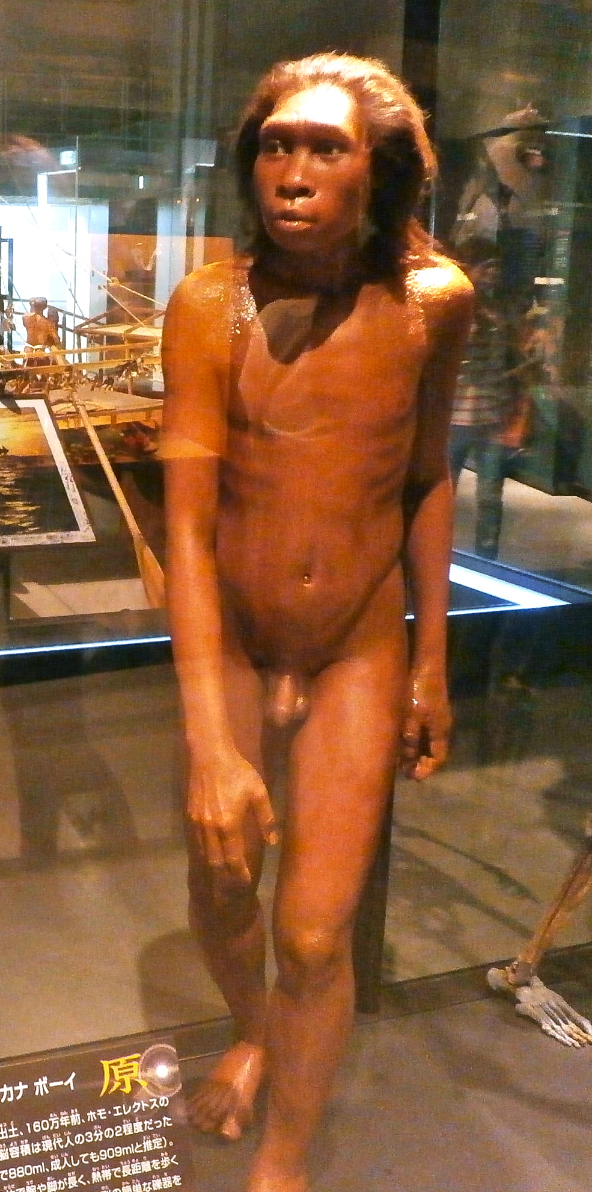
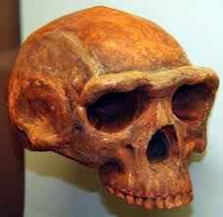
Homo erectus
1.9 mya-143,000 yrs ago
4
CREATIVE COMMONS
Notes:
1. http://upload.wikimedia.org/wikipedia/commons/c/c9/Skeleton_and_restoration_model_of_Turkana_Boy.jpg
By Photaro (Own work) [CC-BY-SA-3.0 (http://creativecommons.org/licenses/by-sa/3.0)], via Wikimedia Commons
2. http://en.wikipedia.org/wiki/File:Homo_erectus.jpg
English: Homo erectus, Museum of Natural History, Ann Arbor, Michigan, November 2007.
Date 20 November 2007, 12:31 Source Homo Erectus
Author Thomas Roche
from San Francisco, USA

Slide 5
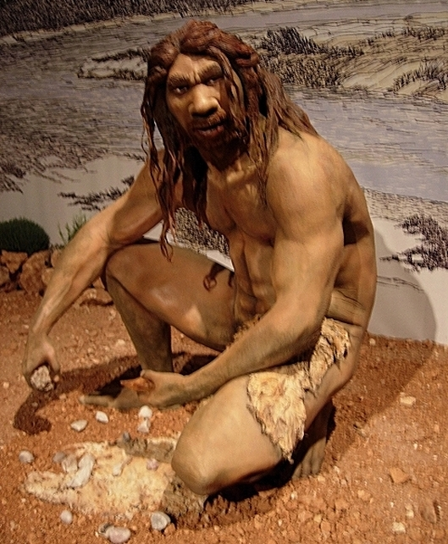
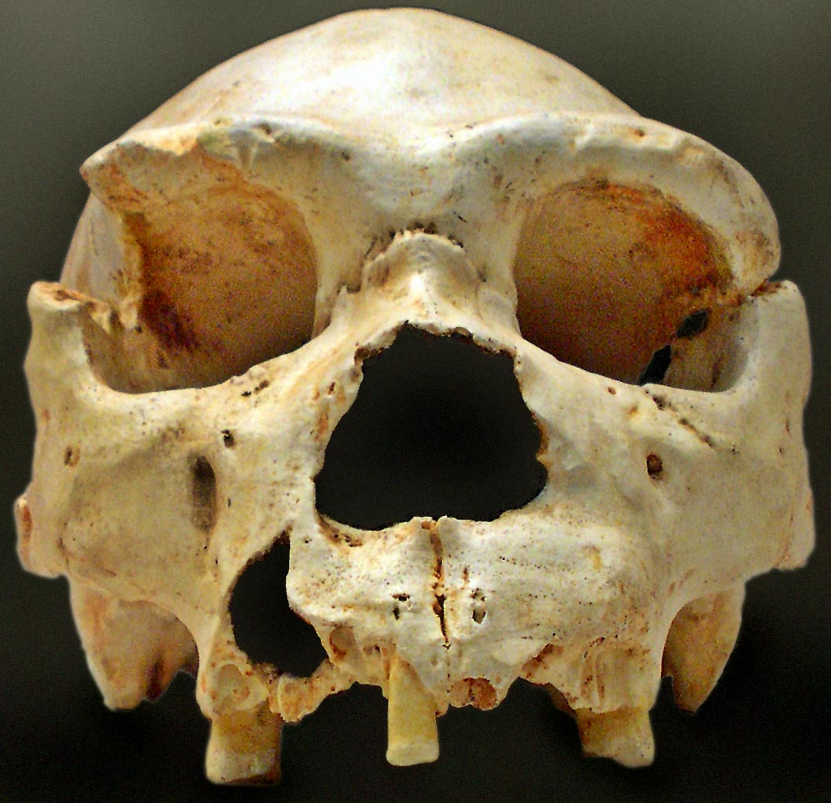
Homo heidelbergensis
700,000-200,000 years ago
3
CREATIVE COMMONS
Notes:
1. http://en.wikipedia.org/wiki/File:Homo_heidelbergensis_%2810233446%29.jpg
Date 15 April 2005, 12:38 Source Homo heidelbergensis
Author Jose Luis Martinez Alvarez
from Asturias, España Other versions Derivative works of this file:
Homo heidelbergensis (10233446) new.jpg
2. http://en.wikipedia.org/wiki/File:Homo_heidelbergensis-Cranium_-5.jpg
English: Cranium 5 is one of the most important discoveries in the Sima de los Huesos, Atapuerca (Spain). The mandible of this cranium appeared, nearly intact, some years after its find, close to the same location.
2006
José-Manuel Benito Álvarez

Slide 6
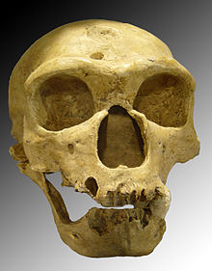
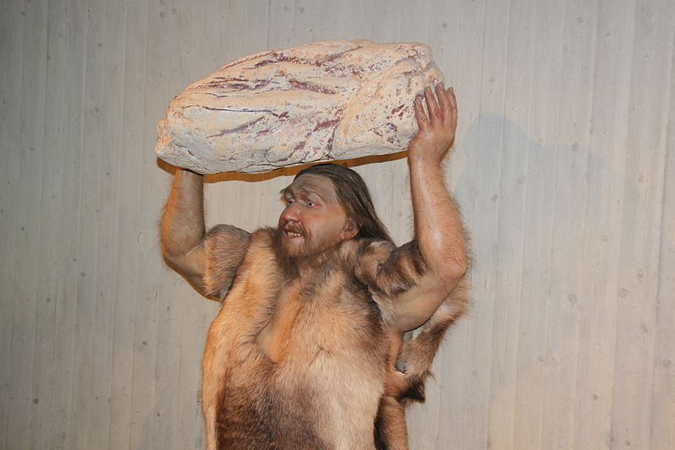
Homo neanderthalensis
200,000-28,000 years ago
2
CREATIVE COMMONS
Notes:
1. http://commons.wikimedia.org/wiki/File:Homo_neanderthalensis_lifting_Rock_close_Reconstruction_-_Museum_Neandertal.jpg
Homo neanderthalensis lifting a heavy rock. One of the original twelve models in Neandertal-Museum (opened 1996).[1]
Date reconstruction: 1996(?) photograph: 2012-02-18 16:40:23 Author: Neozoon
2. http://en.wikipedia.org/wiki/File:Homo_sapiens_neanderthalensis.jpg
English: Homo neanderthalensis. Skull discovered in 1908 at La Chapelle-aux-Saints (France).
Date October 2005 Source Own work Author Luna04 (difficult to find real name; may need to source username)

Slide 7
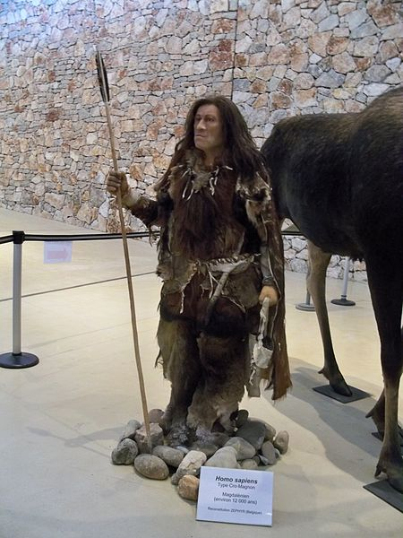
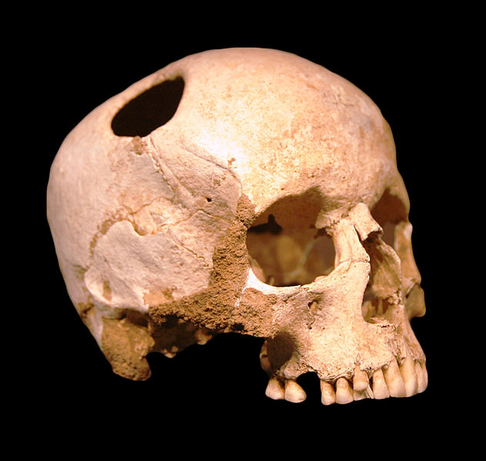
Homo sapiens
200,000 years ago to present
1
CREATIVE COMMONS
Notes:
1. http://commons.wikimedia.org/wiki/File:Homo_sapiens.JPG
Français : Homo sapiens à Quison (04), France
Date 5 February 2011 Source Own work Author Véronique PAGNIER **note this is Cro Magnon; take a photo of a modern day human if you want sapiens sapiens**
2. http://en.wikipedia.org/wiki/File:Crane-trepanation-img_0507_crop.jpg
English: Girl skull, trepanated with a silex; neolithic (3500 BC) ; patient survived. Natural History Museum, Lausanne Credit: Rama

Slide 8
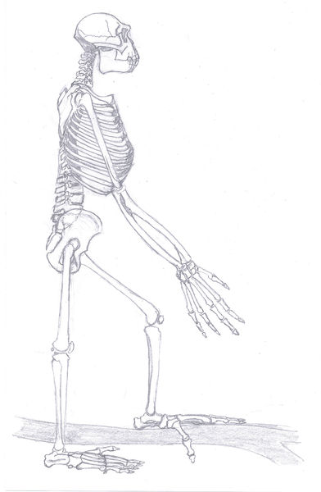
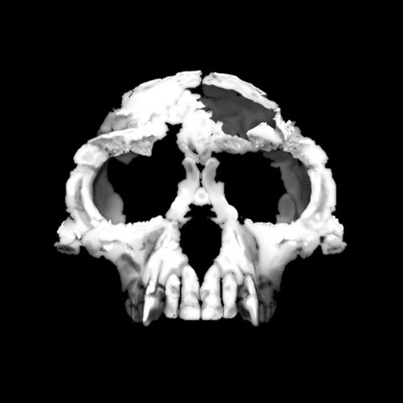
Ardipithecus ramidus (Ardi)
4.6-4.2 mya
8
CREATIVE COMMONS
Notes:
1. English: Ardipithecus ramidus („Ardi“), complete skeleton. Own drawed remake of p.36, "Science" of 2nd October 2009. Date 25 June 2010 Source Own work Author Tobias Fluegel **not sure if we can use if redrawn after the artist’s sketch, although original has skin, etc. and this is just bone…**
2. http://en.wikipedia.org/wiki/File:Ardi.jpg
Ardipithecus ramidus specimen, nicknamed ”Ardi”
After Gen Suwa, Berhane Asfaw, Reiko T. Kono, Daisuke Kubo, C. Owen Lovejoy, Tim D. White (2009): "The Ardipithecus ramidus Skull and Its Implications for Hominid Origins." Science, 2 October 2009: Vol. 326. no. 5949, pp. 68e1-68e7, Fig. 2
Date 14 November 2009, 16:50 Source Zanclean skull
Uploaded by FunkMonk
Author T. Michael Keesey
***Gives sourcing but not by the original authors; We may need to photograph our skull for this one, as images free to use are rare**

